Slide 1
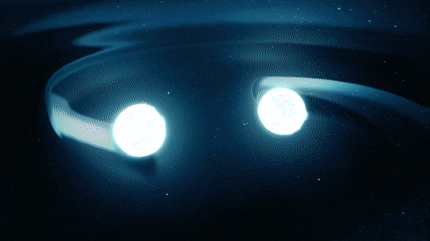
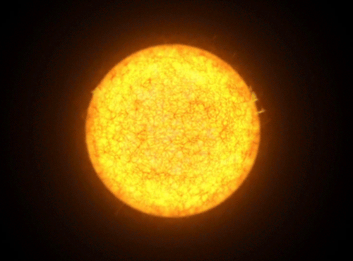

Resolving Age Discrepancy in Three Galactic Cepheids
Sashwat Prasadh, Hilding Neilson, Nancy R Evans
We acknowledge that the lands on which Memorial University’s campuses are situated are in the traditional territories of diverse Indigenous groups, and we acknowledge with respect the diverse histories and cultures of the Beothuk, Mi’kmaq, Innu, and Inuit of this province.

Slide 2
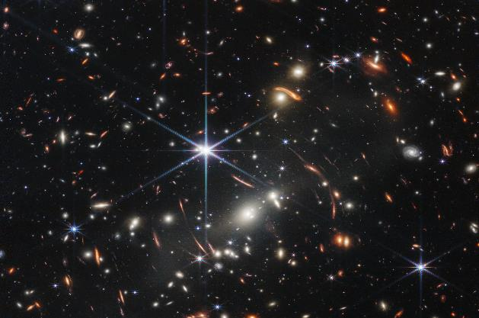
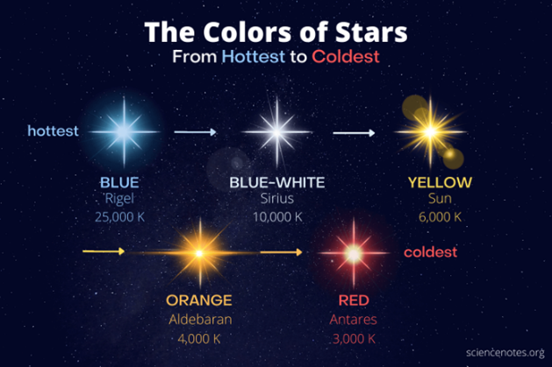
Stellar Evolution
Credit:
Credit: JWST First deep field view

Slide 3
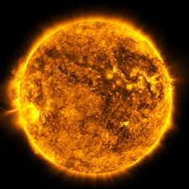

The Sun – A Single Star
A Binary Star System
Credits: NASA
Credits: WikiComms

Slide 4
A Binary Star Systems
Stars in a binary system are supposed to have the same age.

Slide 5
Binary Star Systems and Age Discrepancy
Some of them do not!
Including the star systems that we investigate namely: SV Persei , RW Cameopardalis , and KN Cen

Slide 6
Goal: Resolving this Age Discrepancy

Slide 7
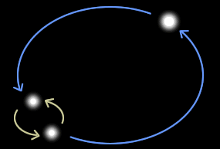
A Hierarchical Triplet
Tertiary/Companion star
Inner Binaries

Slide 8
Hierarchical Triple Star System after formation
-> Binary system today
The Inner Binaries Merge

Slide 9



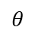
Hierarchical Triplet
Outer Orbit
Tertiary Star
Z axis
Primary star
$$θ$$
Secondary Star
The inner orbital plane at an inclination θ to the outer orbital plane
XY plane

Slide 10

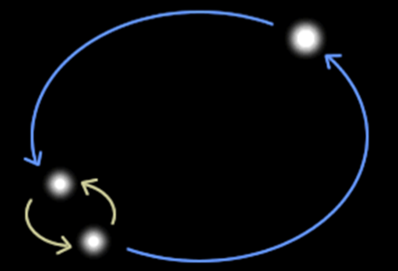
Hierarchical Triple Star System after formation -> Binary system today
Binary system
Notes:
How do we test this Hypothesis?

Slide 11
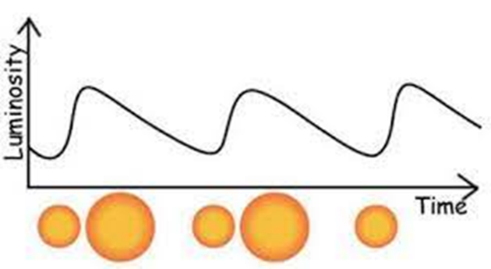
Pulsating Stars → Cepheids
Credits: ESA Science Images
Credits: ESA

Slide 12
The Three Galactic Cepheid Binaries

Slide 13
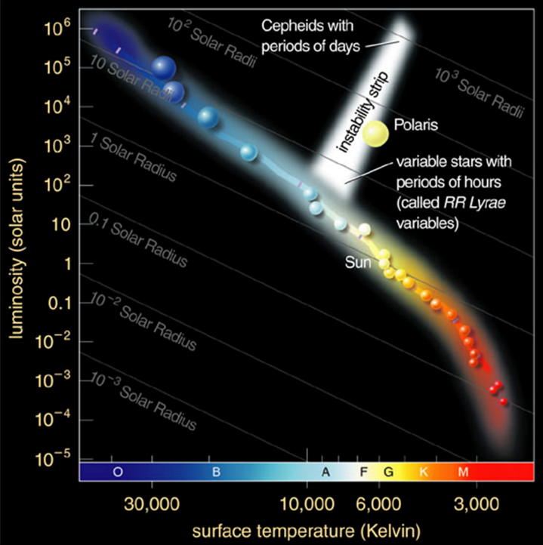
The Hertzsprung-Russell (HR)
Diagram
© 2004 Pearson Education Inc., publishing as Addison-Wesley

Slide 14
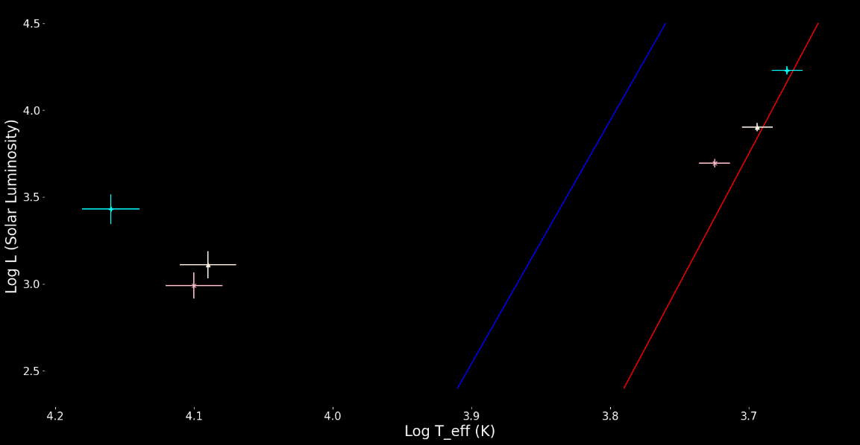
Stars on an HRD
Cepheids
Companions

Slide 15

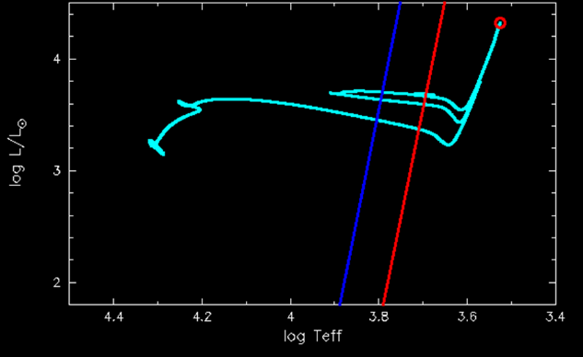

Slide 16
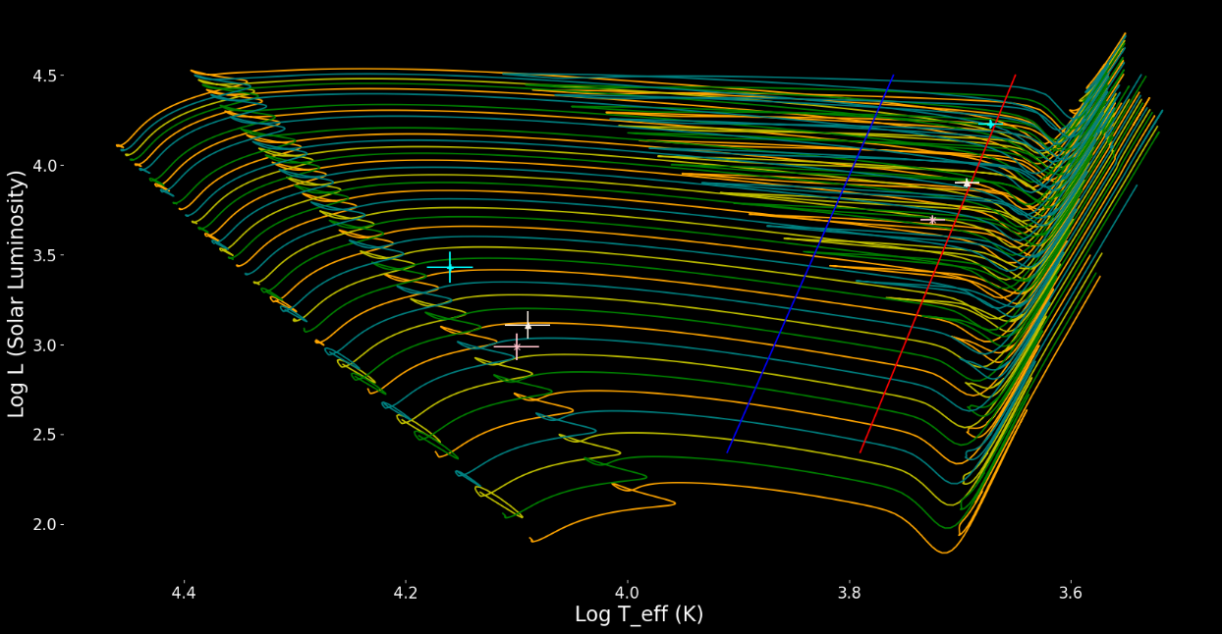
Stars and Tracks
13 M_0
3 M_0

Slide 17
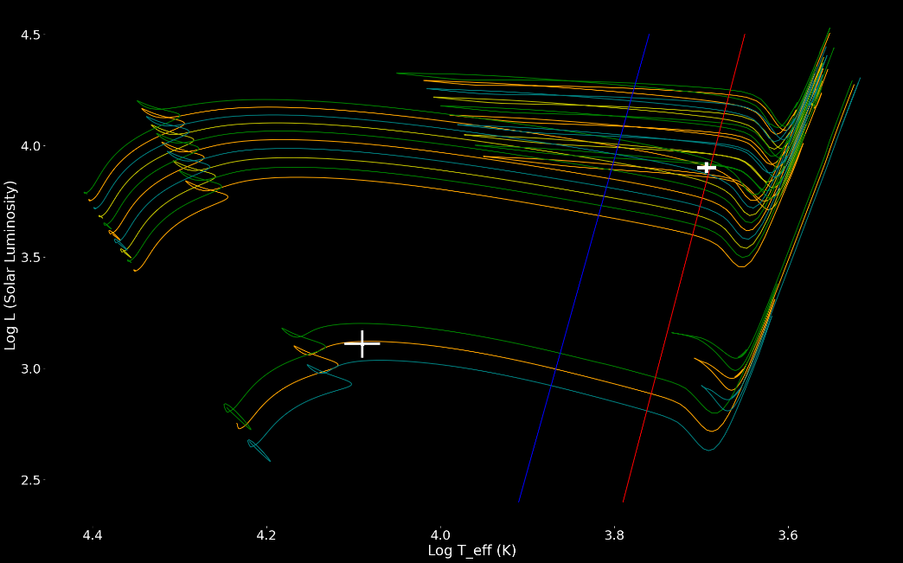
RW Cam – Possible Tracks
8 M_0
5 M_0

Slide 18
Age Discrepancy
Star | Age of Cepheid (Million Years) | Age of Companion (Million Years) | Minimum % Discrepancy
 | Max | Min
SV Per | 45.1 | 90.5 | 50%
RW Cam | 36.9 | 84.0 | 56%
KN Cen | 24.1 | 56.2 | 57%

Slide 19
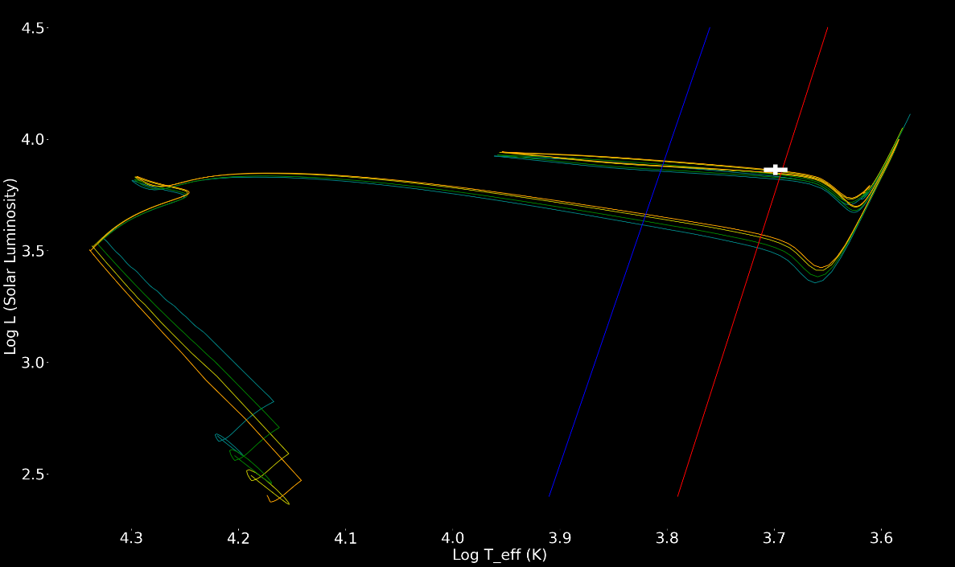
RW Cam- Merger Models
~ 8
Mass accretion
4.5
4.75
Masses
4.25
4

Slide 20
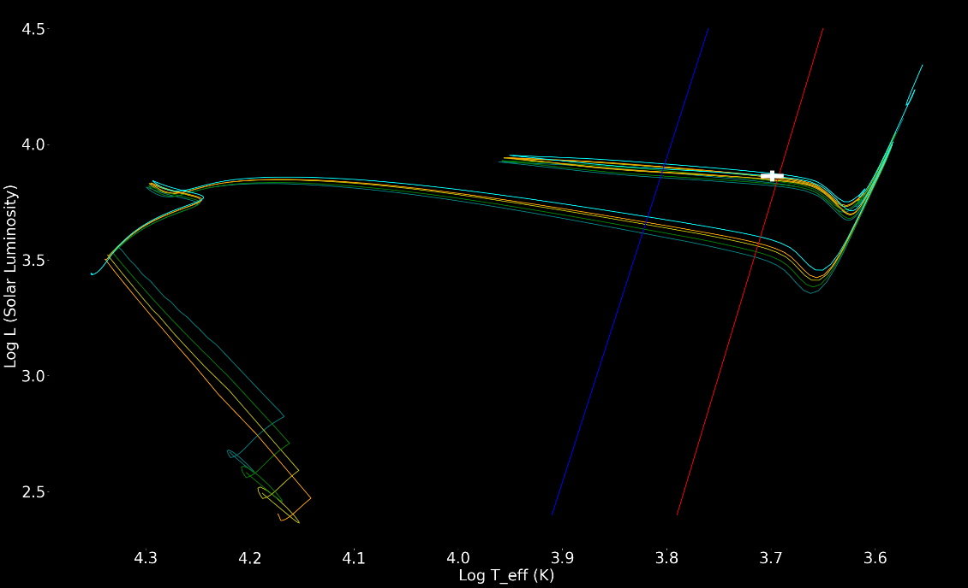
Summary and Comparison
Present Location
Mass accretion
Evolution to a Certain age

Slide 21
Questions?

Slide 22
References
-"Algol-type Variable Binary Star Animation." Wikimedia Commons, https://commons.wikimedia.org/wiki/File:Algol-type_variable_binary_star_animation_5.gif. , Creative Commons CC0 1.0 Universal Public Domain Dedication.
- "Journey Through the Universe: Exploring Galaxies." European Space Agency (ESA), https://esahubble.org/videos/heic1323j/. ,Creative Commons Attribution license (reuse allowed)
- "When Dead Stars Collide." NASA Tumblr, https://nasa.tumblr.com/post/166466378849/when-dead-stars-collide.
- The Sun. NASA Science, https://science.nasa.gov/gallery/the-sun/.
- Cepheid Variable Stars. ESA Science Images, https://sci.esa.int/sci-images/20/cepheid-variables.jpg.
- "The Instability Strip." SlidePlayer, https://slideplayer.com/slide/5752524/19/images/44/%C2%A9+2004+Pearson+Education+Inc.%2C+publishing+as+Addison-Wesley.jpg. , Copyright © 2004 Pearson Education Inc., publishing as Addison-Wesley.
- "Webb's First Deep Field." NASA/ESA/CSA/STScI. Astronomy.com, https://www.astronomy.com/wp-content/uploads/sites/2/2023/03/Webbs_First_Deep_Field.jpg?resize=600%2C450.

